Slide 1
The Functions and Administration of Frequent used nutritional Supplements
Tony X. Zhang CCN, Ph.D

Slide 2
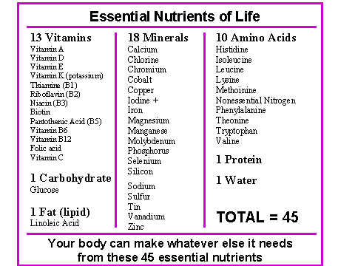

Slide 3
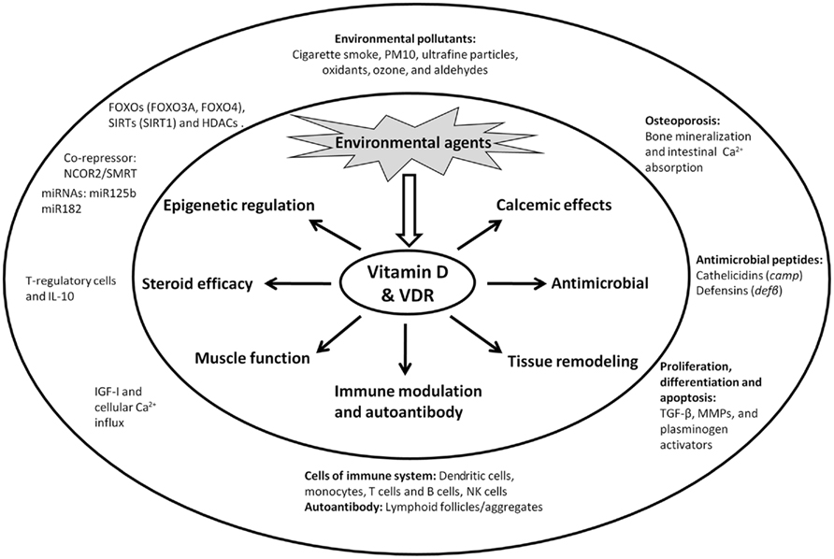
Vitamin D Functions:

Slide 4
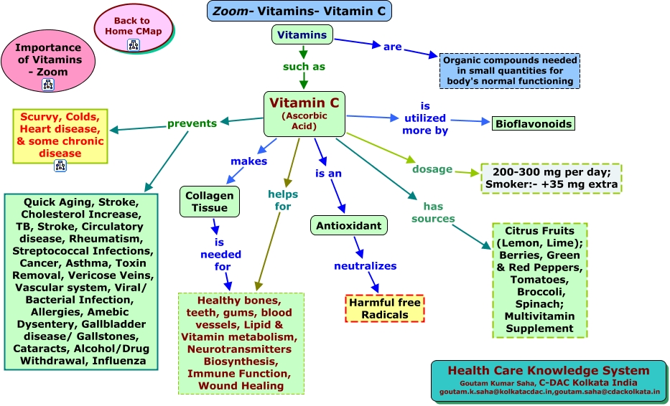
Vitamin C Functions:
4000-10000mg/daily

Slide 7
Folic Acid Functions

Slide 8
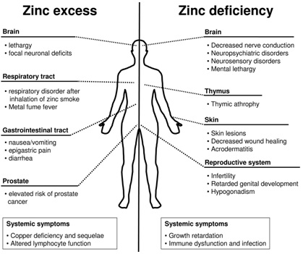

Slide 10
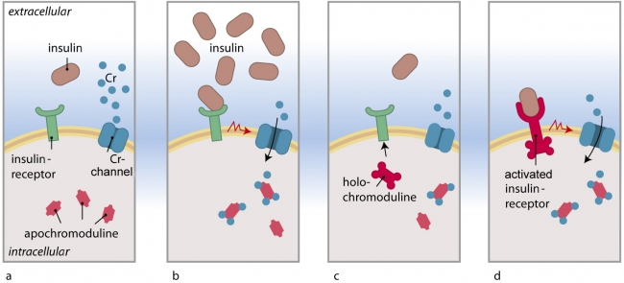
Chromium Function:

Slide 11
